Slide 1
Journal club 9th August 2018
R₃ ต่อพงศ์ แม่นสำรวจการ
อาจารย์นวลวรรณ ภูวโชติโรจนโภคิน

Slide 2
The New England Journal of Medicine
VOL. 378 NO. 24
May 10th, 2018

Slide 3
BACKGROUND
Around 310 million patients worldwide undergo major surgery each year
Clinicians have traditionally administered generous amounts of intravenous fluids perioperatively
Pre-op fasting
Other fluid deficits
Anesthesia-induced vasodilation
Hemorrhage & accumulation of fluid in extravascular spaces
To enhance tissue oxygen delivery and maintain urine output

Slide 4
BACKGROUND
Traditional intravenous-fluid regimens during abdominal surgery
Deliver up to 7 liters of fluid on the day of surgery
Lead to tissue edema and weight gain of 3-6 kg
Restrictive fluid regimen
Fewer complications and a shorter hospital stay in small studies
Recent consensus statements support fluid restriction

Slide 5
BACKGROUND
Enhanced recovery after surgery (ERAS) pathways
Restricting fluids to achieve zero balance is a key component.

Slide 6
BACKGROUND
The evidence for fluid restriction during & after abdominal surgery is inconclusive
Fluid restriction could
Increase the risk of hypotension and
Decrease perfusion to the kidneys & vital organs
Leading to organ dysfunction
Excessive intravenous fluids may
Increase pulmonary complications
Acute kidney injury
Poor wound healing

Slide 7
BACKGROUND
The most effective intravenous-fluid regimen is unclear
Restrictive versus Liberal Fluid Therapy in Major Abdominal Surgery (RELIEF) trial
Compare a restrictive regimen with a traditional (liberal) regimen
In patients who had an increased risk of complications
While undergoing major abdominal surgery

Slide 8
BACKGROUND
Hypothesis
“A restrictive fluid regimen in adults undergoing such
surgery would lead to a lower rate of complications
and a higher rate of disability-free survival than a
liberal fluid regimen”

Slide 9
METHODS
The RELIEF trial
An international, randomized, assessor-blinded trial
Compared a restrictive intravenous-fluid regimen with a liberal regimen
In patients undergoing major abdominal surgery

Slide 10
METHODS
The RELIEF trial
The trial was funded by
The Australian National Health and Medical Research Council
The Health Research Council of New Zealand
The Australian and New Zealand College of Anaesthetists
Monash University
The trial protocol was approved by the institutional review board at each site

Slide 11
METHODS
Patient Selection and Randomization
Adult patients who had an increased risk of complications while undergoing major abdominal surgery

Slide 12
METHODS
Inclusion criteria
1. Adults (≥18 years) undergoing elective major surgery and providing informed consent
2. All types of open or laparoscopic-assisted abdominal or pelvic surgery with duration ≥ 2hrs, hospital stay ≥ 3 days
(eg, oesophagectomy, gastrectomy, pancreatectomy, colectomy, aortic or aorto-femoral vascular surgery, nephrectomy, cystectomy, open prostatectomy, radical hysterectomy and abdominal incisional hernia repair).

Slide 13
METHODS
Inclusion criteria
3. At increased risk of postoperative complications( 1 of followings)
Age ≥70 years
Coronary heart disease
DM on medication
Renal impairment (Cr>2.8 mg/dl)
Morbid obesity (BMI ≥35 kg/m2)
Preoperative serum albumin <30 g/L
Anaerobic threshold (if done) <12 mL/kg/min
Or 2 or more of the following risk factors

Slide 14
METHODS
Inclusion criteria
3. At increased risk of postoperative complications( 1 of followings)
Or 2 or more of the following risk factors
ASA 3 or 4
Chronic respiratory disease
Obesity BMI 30–35 kg/m2
Aortic or peripheral vascular disease
Hb <10 mg/dL
serum creatinine >1.7 mg/dL
anaerobic threshold (if performed) 12–14 mL/kg/min.

Slide 15
METHODS
Exclusion criteria
1. Urgent or time-critical surgery
2. ASA physical status 5
3. ESRD requiring dialysis
4. Pulmonary or cardiac surgery, Liver resection
5. Minor or intermediate surgery, such as LC, TURP, Inguinal hernia repair

Slide 16
METHODS
Patient Selection and Randomization
After enrollment, on the day of surgery
1. Complete the 12-item WHO Disability Assessment Schedule (WHODAS)
2. randomly assigned in a 1:1 ratio to a trial group

Slide 18
METHODS
WHODAS 2.0 covers 6 Domains of Functioning, including:
Cognition – understanding & communicating
Mobility– moving & getting around
Self-care– hygiene, dressing, eating & staying alone
Getting along– interacting with other people
Life activities– domestic responsibilities, leisure, work & school
Participation– joining in community activities

Slide 19
METHODS
Trial Treatments
The liberal intravenous-fluid regimen >> control
The restrictive intravenous-fluid regimen >> intervention

Slide 20
METHODS
Trial Treatments : The liberal intravenous-fluid regimen
IV Bolus of Balance salt crystalloid at a dose of 10 ml/kg during the induction of anesthesia
Followed by a dose of 8ml/kg/hr
Peri-operative dose reduced after 4 hours if clinically indicated
Fluid volumes were calculated on a maximal BW of 100 kg
Postoperative dose were 1.5ml/kg/hr for at least 24 hours
This dose could be reduced or increased

Slide 21
METHODS
Trial Treatments : The restrictive intravenous-fluid regimen
Designed to provide a net zero fluid balance
IV fluid Bolus ≤ 5ml/kg during the induction of anesthesia
Followed by a dose of 5ml/kg/hr until the end of surgery
Postoperative dose were 0.8ml/kg/hr for at least 24 hours
The total fluid during the first 24-hour period was expected to be approximately half that in the liberal fluid group

Slide 22
METHODS
Treatment Assignments : Management common to both groups
Bolus colloid or blood used intra-operatively to replace blood loss
Alternative fluid types (other crystalloid, dextrose, or colloid) and electrolytes were allowed postoperatively
Oliguria was not used as an indication for the additional IV fluid
All other peri-operative care was performed according to the discretion and practices of local clinicians

Slide 23
Liberal
Restrictive

Slide 24
METHODS
Blinding and Data Quality
Patients were blinded to group allocation
Attending anesthesiologist, medical & nursing staff who were caring for patients were not blinded
All research staff members who were responsible for the primary outcome remained blinded and unaware of group

Slide 25
METHODS
Measurements and Patient Follow-up
Patients were followed during admission & up to 1 year after surgery
WHODAS questionnaires
Repeated on day 30, 3 months, 6 months, and 12 months after surgery
Ascertain survival status and new-onset disability

Slide 26
METHODS
Measurements and Patient Follow-up
Surgical-site infection, pneumonia, or other septic complications up to 30 days
Renal-replacement therapy up to 90 days & Death during first year
The quality of the recovery
A validated 15-item quality-of-recovery scale (QoR-15)
At 3 months after surgery

Slide 27
METHODS
Trial Outcomes
The primary outcome
Secondary outcomes
Disability-free survival
up to 1 year after surgery
Acute kidney injury
Renal-replacement therapy at 90 days
A composite of 30-day mortality or major septic complications
Serum lactate level, peak C-reactive protein level, blood transfusion, duration in ICU & hospital, unplanned ICU and quality of recovery

Slide 28
METHODS
The primary outcome : Disability-free survival up to 1 year after surgery
Disability was defined as a persistent impairment in health status ≥ 6 months
Measured by a score of at least 24 points on the WHODAS questionnaire
The WHODAS questionnaire was completed by the patient or by a proxy

Slide 29
METHODS
Secondary outcomes : Define as
Acute kidney injury
KDIGO creatinine criteria, not urine output
Adjusted post-operative serum creatinine in restrictive group
A composite of 30-day mortality or major septic complications
Sepsis
Surgical site infection
Anastomotic leak
Pneumonia

Slide 30
METHODS
Statistical Analysis
A modified intention-to-treat analyses
All the patients who had undergone randomization & induction of anesthesia
A target of 2800 patients was initially defined
Based upon an expected disability-free survival at 1 year of 65%
Type I error of 0.05 & power of 90% to detect a hazard ratio of 0.80 using the log-rank test
Included additional 5.7% to account for withdrawals & loss to follow-up

Slide 31
METHODS
Statistical Analysis
The sample size was increased to 3000 after 2578 patients were randomised
A greater than expected disability-free survival rate at 1 year
This provided a final power of 80% to detect a hazard ratio of 0.78

Slide 32
METHODS
Statistical Analysis
Primary outcome
A Cox proportional hazards model
Kaplan–Meier survival curves for graphical display
Secondary outcomes
log-binomial regression or exact logistic regression
Cox proportional hazards regression
Linear regression with robust standard errors or median regression

Slide 33
METHODS
Statistical Analysis
Subgroup analysis
sex, age quartile,
Location of trial center (country)
Presence or absence of colorectal surgery
Use or nonuse of a goal-directed device
Analyses of heterogeneity
Treatment-by-covariate terms added to the Cox regression models

Slide 34
RESULTS
Patient Enrollment and Follow-up
47 centres in 7 countries
The mean number of patients per site was 64 (range: 1 to 227)
May 2013 – Sept 2016
5223 met eligibility criteria after screening;
3000 patients were randomized
2983 (99.4%) met the inclusion criteria for the modified intention-to treat population

Slide 35
RESULTS : Demographic & Characteristics

Slide 36
RESULTS : Demographic & Characteristics
No significant differences in baseline characteristics between the two groups

Slide 37
RESULTS : Trial Treatment

Slide 38
RESULTS : Trial Treatment
Patients in the restrictive fluid group
More likely to receive vasopressor support (P = 0.02)
Lower urine output (P<0.001)
Higher incidence of oliguria or anuria (P<0.001)
Less likely to require red-cell transfusion (P = 0.02)
Less gain weight during the first 2 days after surgery

Slide 39
RESULTS : Primary Outcome
Primary outcome
No difference in disability-free survival up to 1 year after surgery

Slide 40
RESULTS : Primary Outcome
Kaplan–Meier survival curves

Slide 41
RESULTS : Primary Outcome

Slide 42
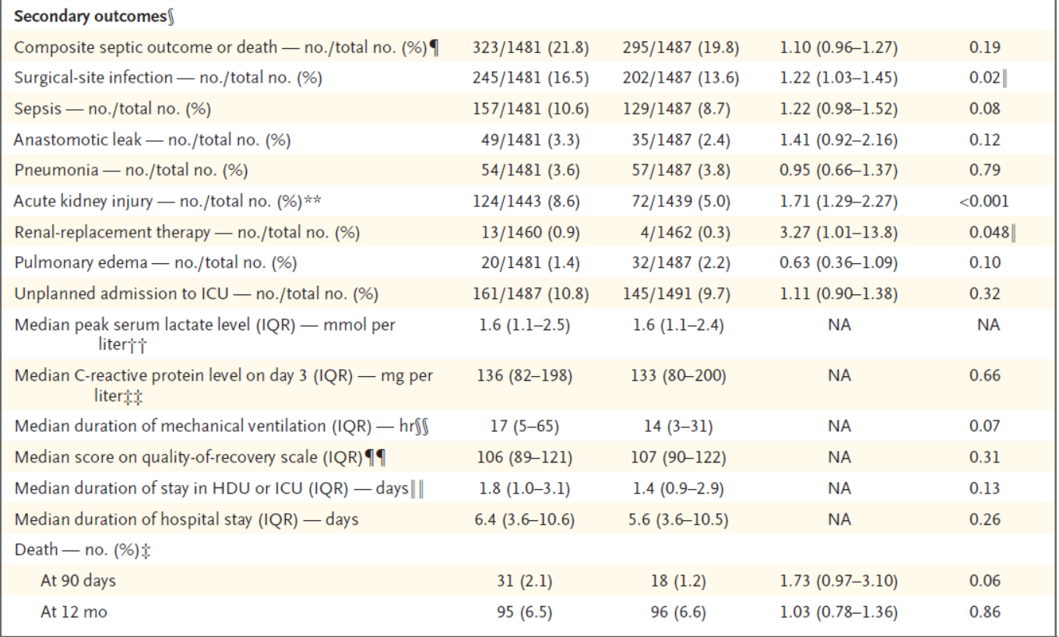
RESULTS : Secondary Outcomes

Slide 43
RESULTS : Secondary Outcomes
AKI at 30 days occurred more commonly in the restrictive fluid group
Risk Ratio (RR): 1.71 (95% CI 1.29 to 2.27; P < 0.001)
Absolute Risk Increase (ARI): 3.59% (95% CI 1.76% to 5.42%; P <0.001)
Number needed to harm (NNH): 28

Slide 44
RESULTS : Secondary Outcomes
RRT at 90 days occurred more frequently in the restrictive fluid therapy group
But did not reach statistical significance after adjustment for multiple analyses
Restrictive fluid group 0.9% vs Liberal fluid group 0.3%
Risk Ratio: 3.27 (95% CI 1.01 to 13.8; P = 0.048)
Threshold to reject null hypothesis was P = 0.004

Slide 45
RESULTS : Secondary Outcomes
Surgical site infection occurred more frequently in the restrictive fluid group
But this again was not significant after appropriate adjustment
Restrictive fluid group 16.5% vs Liberal fluid group 13.6%
Risk Ratio: 1.22 (95% CI 1.03 to 1.45; P = 0.02)
Threshold to reject null hypothesis was P = 0.003

Slide 46
RESULTS : Sensitivity Analyses
Patients alive and free of new-onset disability at 1 year was
81.4% in the restrictive fluid group
83.3% in the liberal fluid group
P = 0.13 by Cox regression
Results were largely unchanged after adjustment for stratification factors

Slide 47
DISCUSSION
This international trial evaluating
Disability-free survival and rates of serious complications among at-risk patients undergoing major abdominal surgery
Compare the administration of IV fluid
A restrictive regimen VS a liberal fluid regimen
Rate of disability-free survival was not significantly difference
But patients in the restrictive fluid group had a significantly higher risk of AKI

Slide 48
DISCUSSION
Perioperative intravenous-fluid therapy
Restore & maintain body water, electrolytes, and organ perfusion
Inappropriate fluid balance approaches can be harmful
Acute kidney injury may result from inadequate or excessive administration
Restricting intravenous-fluid administration
increased the risk of acute kidney injury

Slide 49
DISCUSSION
In this trial : Amount of IV fluid
Restrictive fluid group received
A median of 1.7 liters intraoperatively
Additional 1.9 liters during the 24-hour postoperative
Liberal fluid group received
A median of 3.0 liters intraoperatively
Additional 3.0 liters during the first 24 hours
Similar to the amount recorded in registry data and pooled analyses of trials

Slide 50
DISCUSSION
Findings in this study should not be used to support excessive administration of IV fluid
There is a belief that fluid-induced edema impairs wound healing
A higher rate of surgical site infection in the restrictive fluid group,
Wound or anastomotic hypoperfusion.

Slide 51
DISCUSSION
Limitations
Clinicians not blinded
Less than half of the patients were treated according to ERAS principles
Fluid administration after 24 hours of surgery was not controlled
Many patients were not weighed on days 1-3

Slide 52
CONCLUSION
Among patients at increased risk for complications during elective major abdominal surgery
“A restrictive fluid regimen was not associated with a higher rate of disability-free survival than a liberal fluid regimen but associated with a higher rate of acute kidney injury”

Slide 53
Critical Appraisal : RCT
Does this study address a clear question?

Slide 54
Critical Appraisal : RCT
Are the results of this single trial valid?
Notes:
คิดตามสิ่งที่เราตั้งใจจะให้เขาทำตั้งแต่แรก ก็คือไม่ว่าคุณจะเอายากลับไปกินหรือไม่กิน เราก็จะถือว่าคุณอยู่ในกลุ่มยา เรียกว่าแบบ intention-to-treat
ข้อที่ดีกว่าเป็นอย่างมากของแบบที่สองนี้คือว่ามันยังรักษาความที่มันเกลี่ย ลักษณะที่เรา random ไว้ตั้งแต่แรกไว้ด้วยครับ ดังนั้นหากไม่มี intention to treat แล้วจริงๆ ก็ไม่รู้ว่าจะ randomize ไปทำไม ทำให้ขาดความน่าเชื่อถือไปเป็นอย่างมากครับ ซึ่งโดยส่วนใหญ่เดี๋ยวนี้ผู้วิจัยก็รู้กันและจะทำการวิเคราะห์แบบ intention-to-treat อยู่แล้ว ยกเว้นผู้วิจัยกลุ่มเล็กๆ ที่ยังไม่เคยรู้จัก EBM ครับ

Slide 55
Critical Appraisal : RCT
Are the results of this single trial valid?

Slide 56
Critical Appraisal : RCT
What were the results?
Hazard or Risk ratio
YES
Notes:
w

Slide 57
Critical Appraisal : RCT
Can I apply these valid, important results to my patients?

